Slide 1


Communication Design
# LAB.3 Preprocessing Signals
Ass.Lec.Ammar Alabbassi

Slide 2
Outline:
Preprocessing signals
Resample Signals
Extract Interesting Regions
Custom Preprocessing Function
Align Signals

Slide 3
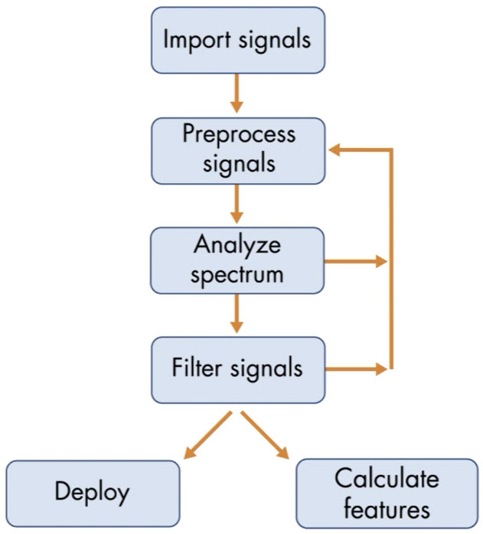
Signal Processing Overview
Generate signals……………………..done
Import the signals into MATLAB…………………done
Preprocess the signals in the time domain to prepare them for analysis
Look at the power spectrum in the frequency domain
Filter the signals to keep only relevant frequency content
Revisit earlier steps in the process to refine your algorithm
Extract information from the signals or deploy your algorithm to hardware
Generate signals

Slide 4
Quiz
1- Specify a sample rate of 300 Hz in a variable named fs. Then create a signal named (t) that extends from 0 seconds to 15 second, with time steps that are 1/fs.
2- Create a 2 Hz sine signal named (sig) at the sample times in t.
3- Create a vector of normally distributed random numbers named noise that is the same size as (sig) and will be added to the original signal (sig) to generate a new signal named (signoise) that makes distortion about 20% of the original signal (Sig).
4- plot the original signal (sig) and noisy signal (signose).
5- Finally, import them into the signal analyzer and view the signals in time and frequency domains .

Slide 5
Resample Signals

Slide 6
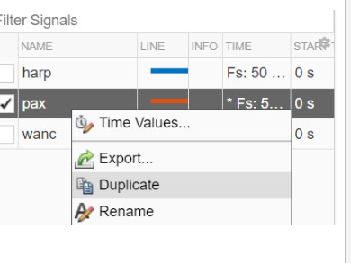
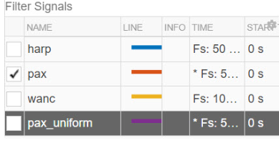
Task 1
Before you modify a signal, it is best practice to duplicate the signal so that you can compare the signal before and after processing. To process a signal, follow these steps:
1- Duplicate the pax signal by right-clicking
it in the Signal table and selecting Duplicate.
2- Rename the duplicate pax_uniform by
right-clicking it and selecting Rename.

Slide 7
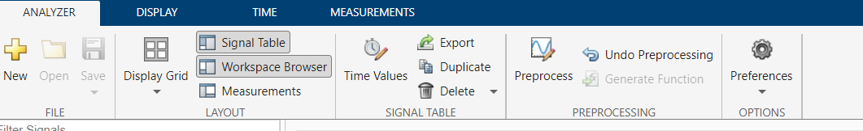
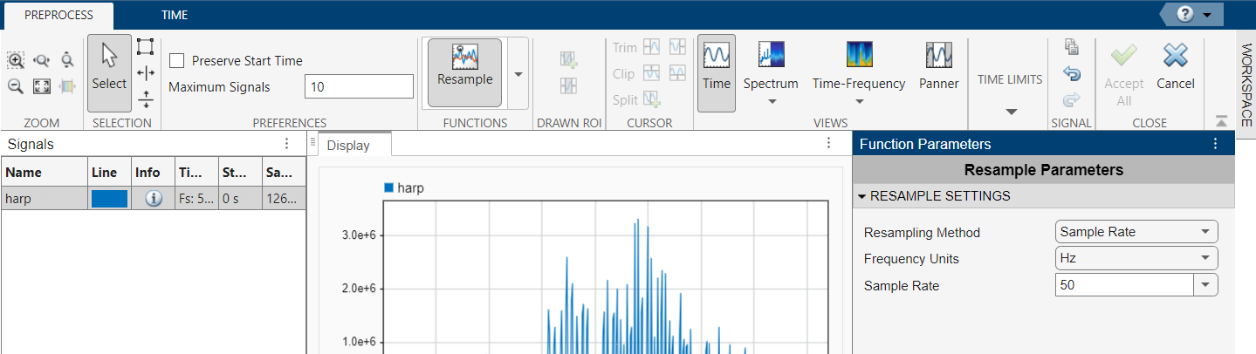
Task 1
3- Click Preprocess in the Analyzer tab of toolstrip to enter preprocessing mode
4- In the Functions section, select Resample

Slide 8
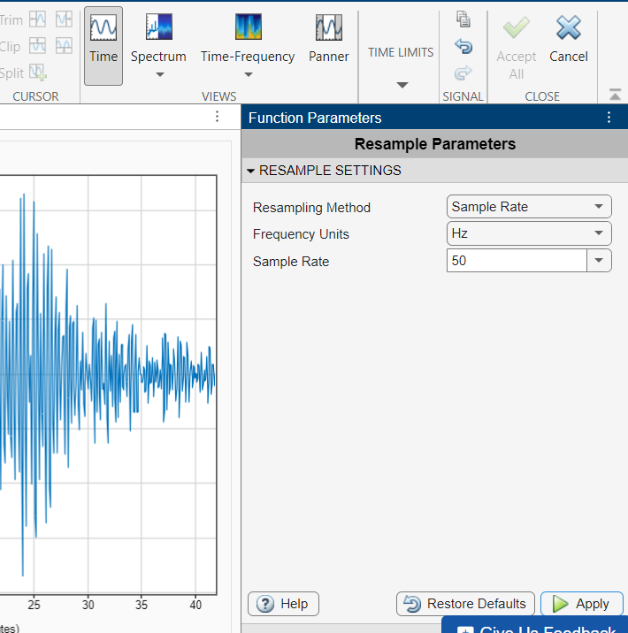
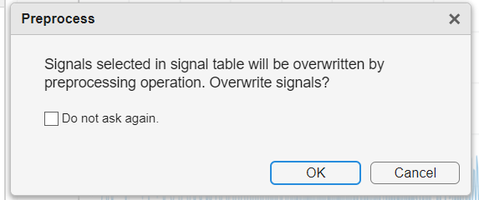
Task 1
5- Set the sample rate to 50 Hz in the Function Parameters panel
6- Click Apply
7- Click Ok on the Preprocess warning dialog
8- Click Accept All in the Close section of the
toolstrip to leave preprocessing mode

Slide 9
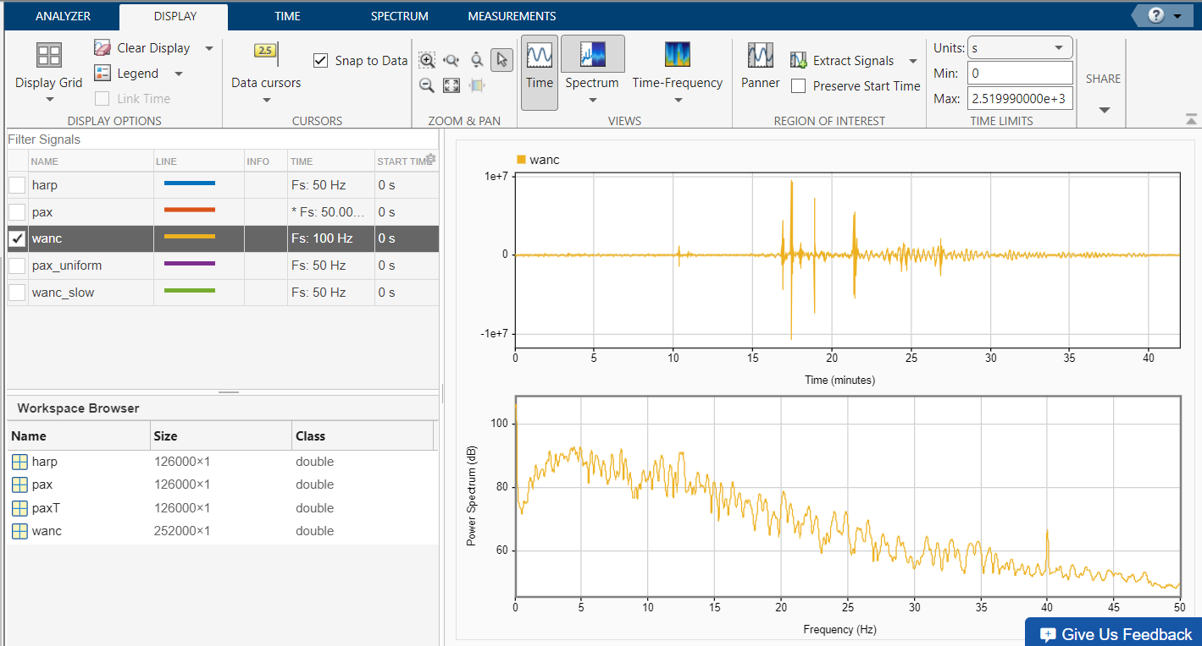
Task 2
The signal recorded at the Wrangell station has a faster sample rate of 100 Hz.
# TASK
Look at the full frequency range of the wanc signal's power spectrum.

Slide 10
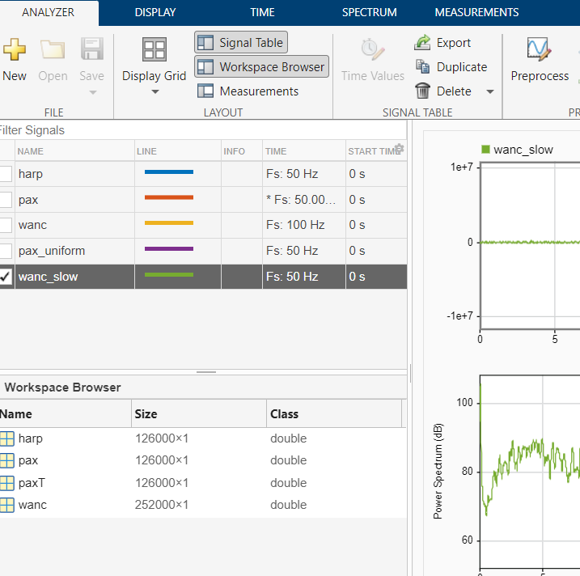
Task 3
1-When you resample to a slower sample rate, frequency content above fs/2 , where fs is the sample rate after resampling, can distort the power spectrum.
2- In the WANC signal, there isn't significant power above 25 Hz, so you can try resampling the WANC signal to 50 Hz so that it matches the sample rate of the HARP and PAX signals.
# TASK
* Duplicate wanc and rename the copy wanc_slow. Then resample wanc_slow by a Sample Factor of 0.5.
* Display the original and resampled signals to compare the effects of resampling.

Slide 11
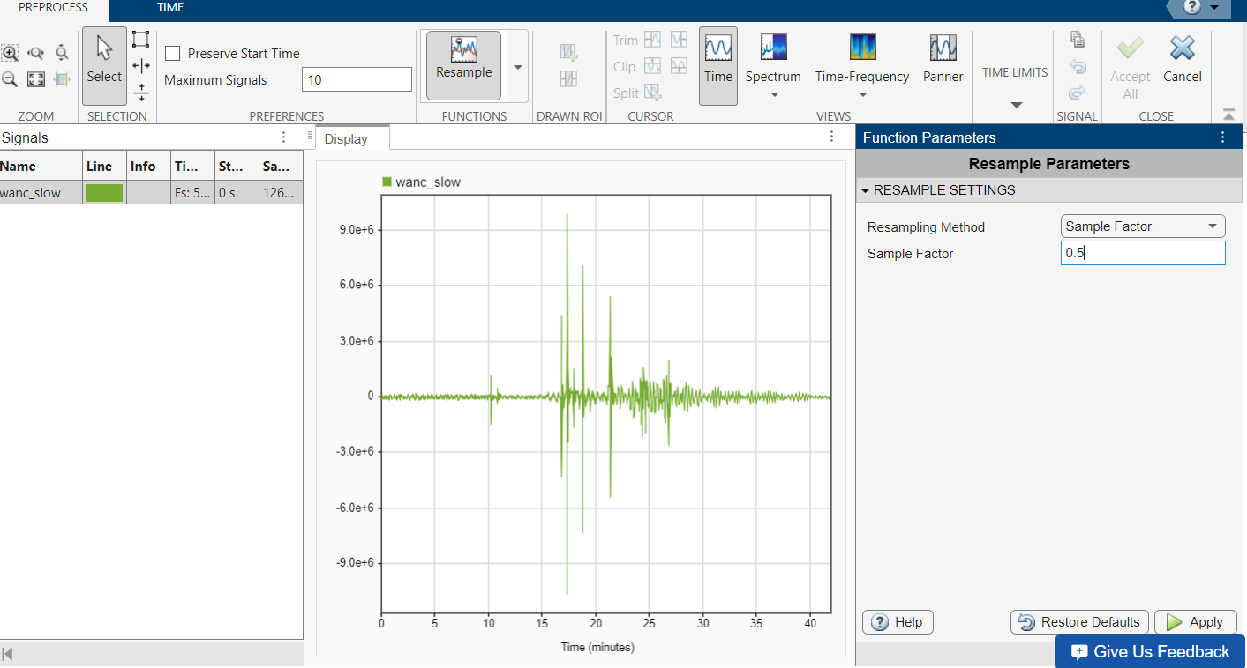
Task 3
# TASK
* Duplicate wanc and rename the copy wanc_slow. Then resample wanc_slow by a Sample Factor of 0.5.
* Display the original and resampled signals to compare the effects of resampling.

Slide 12
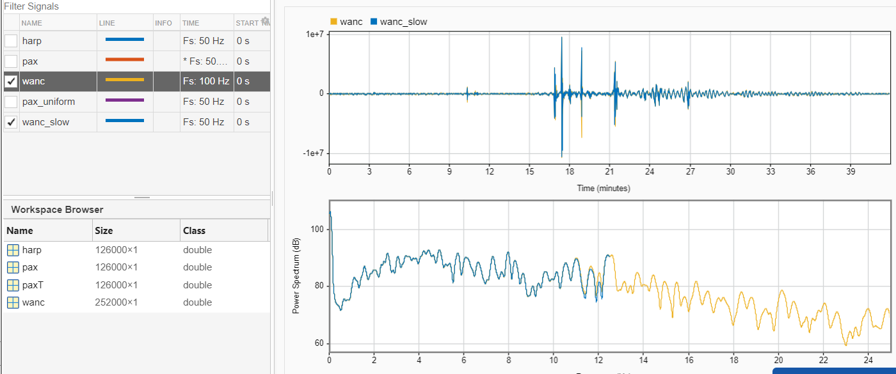

Slide 13
Extract Interesting Regions

Slide 14
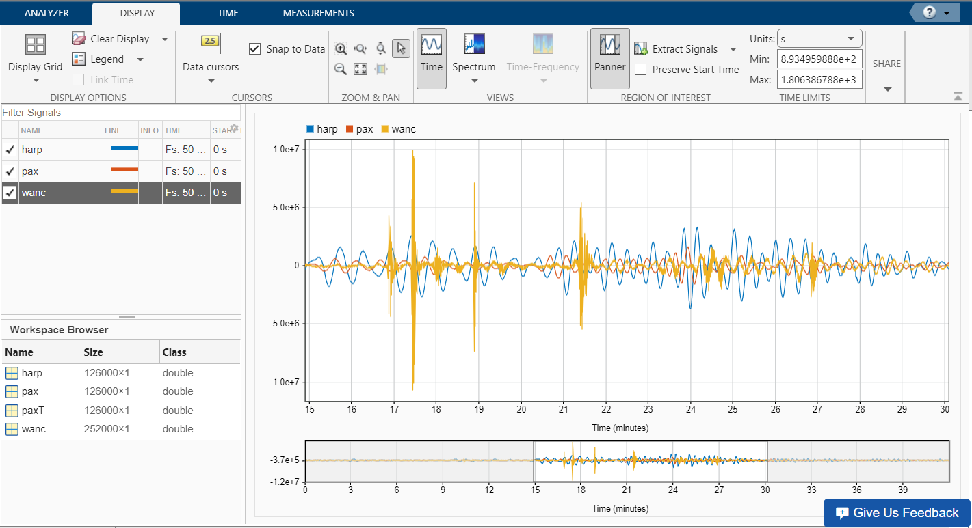
Task 1
Most of the activity in the signals from the HARP and PAX stations occurs in a smaller portion of the signal. You can zoom in on interesting regions. On the Display tab, locate the Region of Interest section and select the Panner tool.
#TASK
Use the panner to display about 12 minutes to 18 minutes.

Slide 15
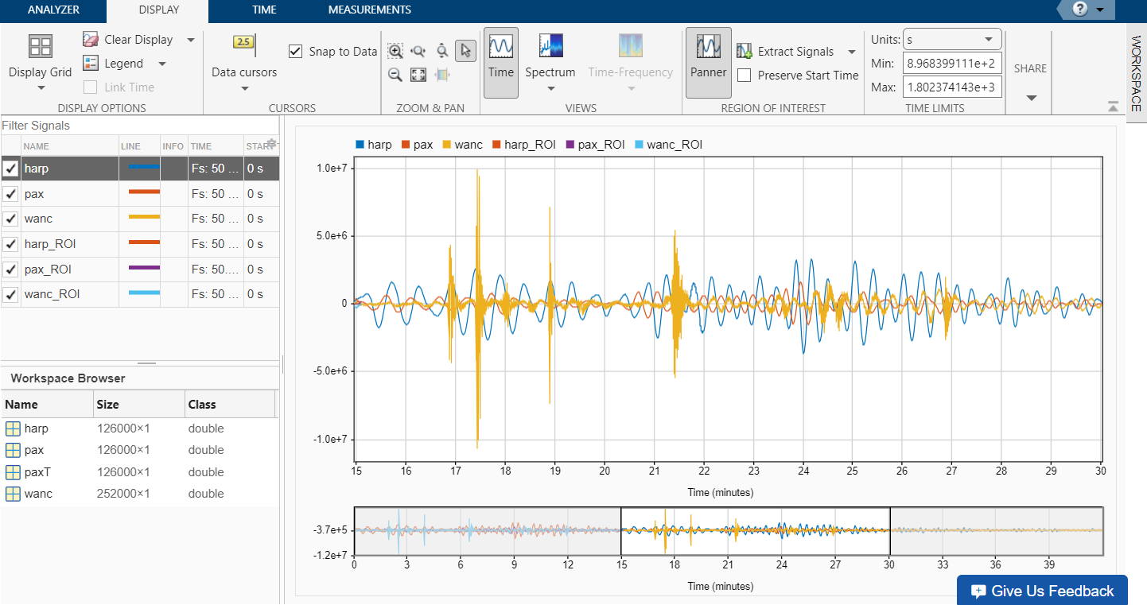
Task 2
You can extract the data from the surface waves by removing extra points before and after. On the Display tab, you can find the Extract Signals option in the Region of Interest section.
# TASK
Extract the selected region from the harp, pax, and wanc signals. Make sure that the extracted signals are named harp_ROI, pax_ROI, and wanc_ROI respectively and display them.

Slide 16
Custom Preprocessing Function

Slide 17
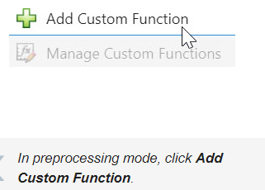
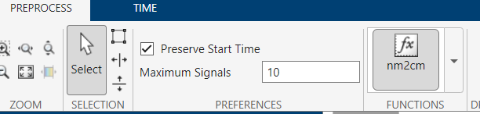
Task 1
The y-axis of the seismic signals is displacement in nanometers, but it can be easier to interpret the displacement in centimeters. If you want to preprocess your signals with a method not built into Signal Analyzer, you can add a custom function. Once you're in preprocessing mode, select Add Custom Function at the bottom of the Functions dropdown . A function named nm2cm has been provided to convert the signals from nanometers to centimeters. so the function file already contains.
function [y,t] = nm2cm(x,t)
y = x/1e7;
End
# TASK
Duplicate the harp, pax, and wanc signals and append _cm to the signal names. For example, duplicate harp and name the result harp_cm.
The function nm2cm has been written for you. Use the custom preprocessing function nm2cm to process the three new signals so that their units are in centimeters instead of nanometers. Then display the three new signals in the time domain.

Slide 18
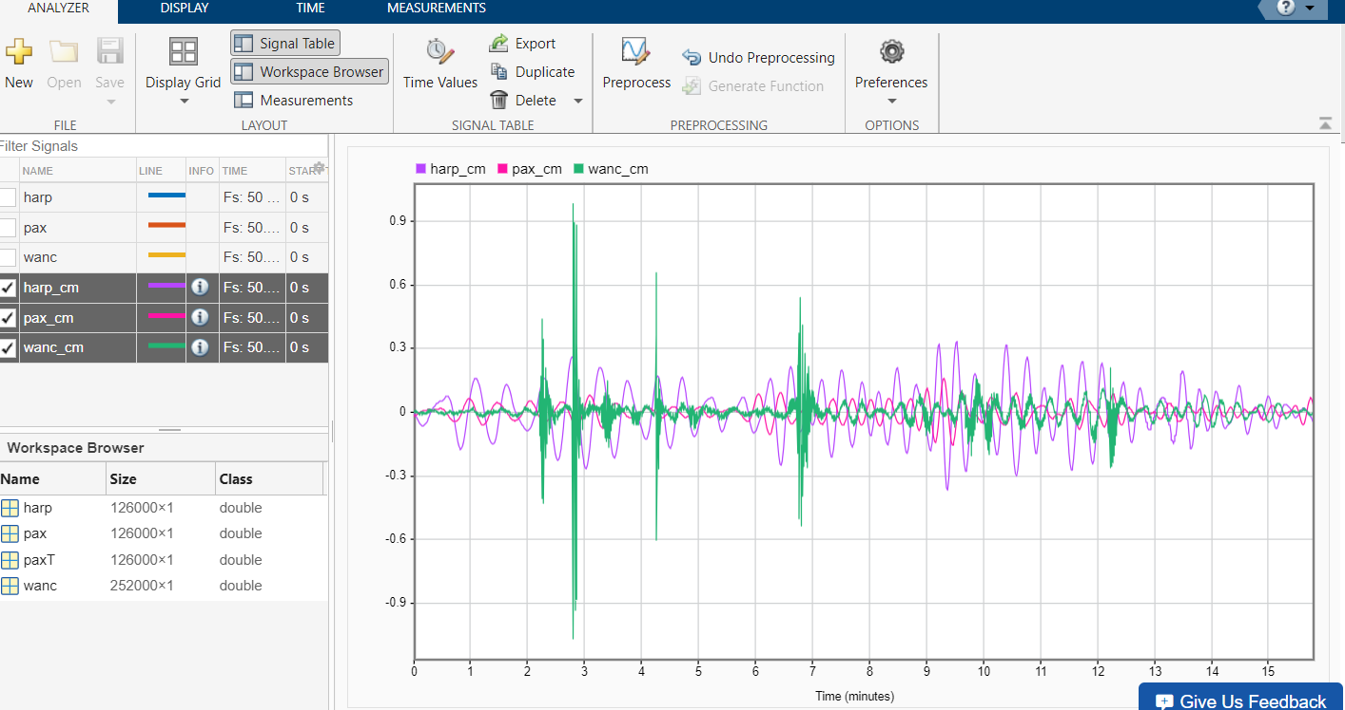
Task 1

Slide 19
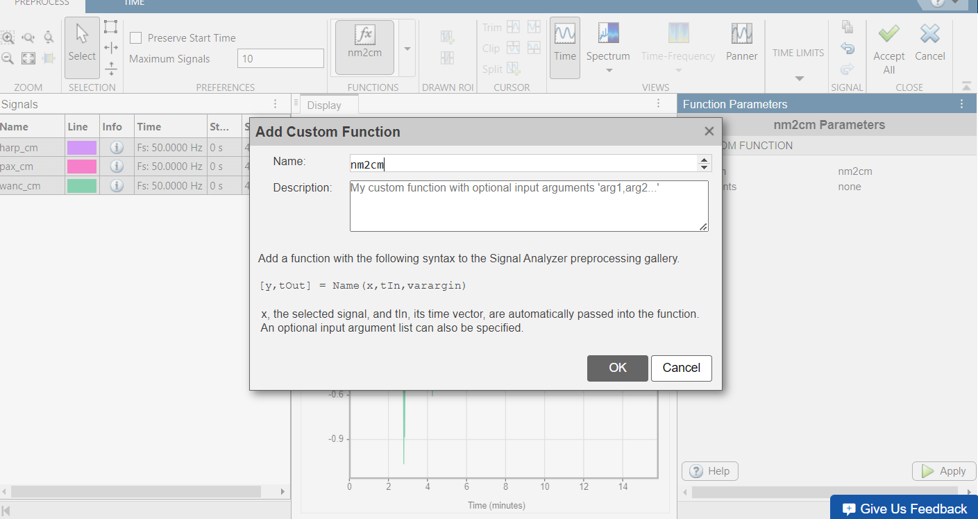
Task 1

Slide 20
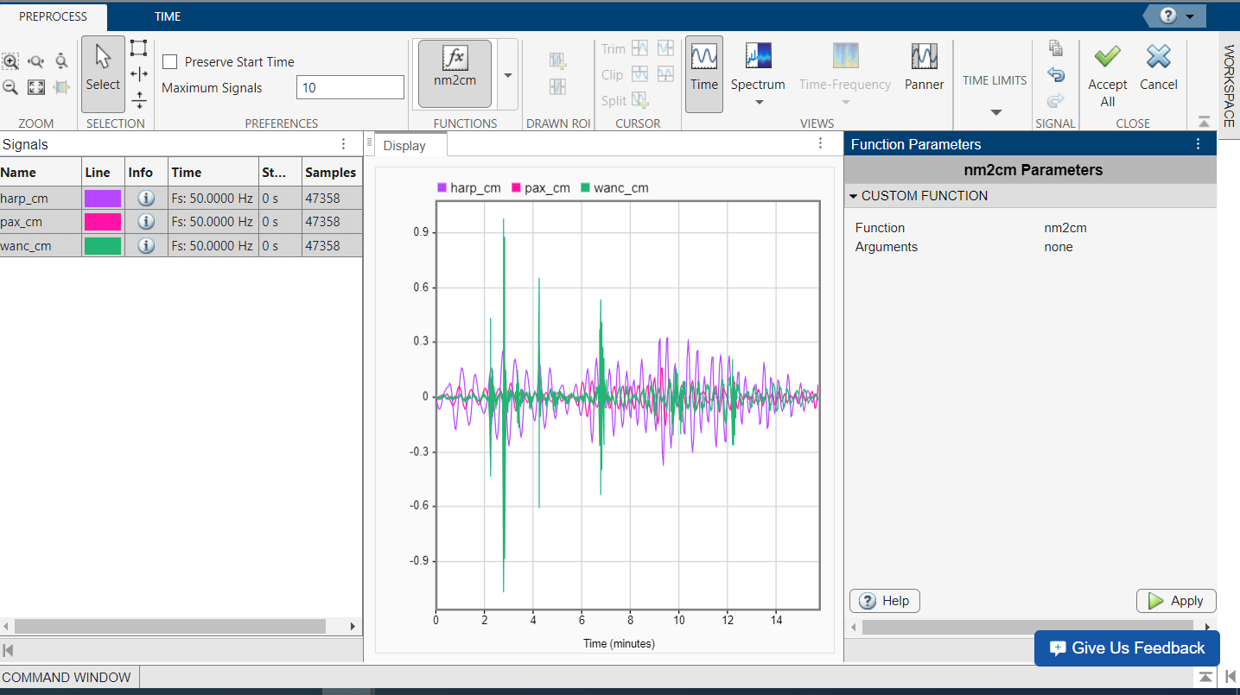
Task 1

Slide 21
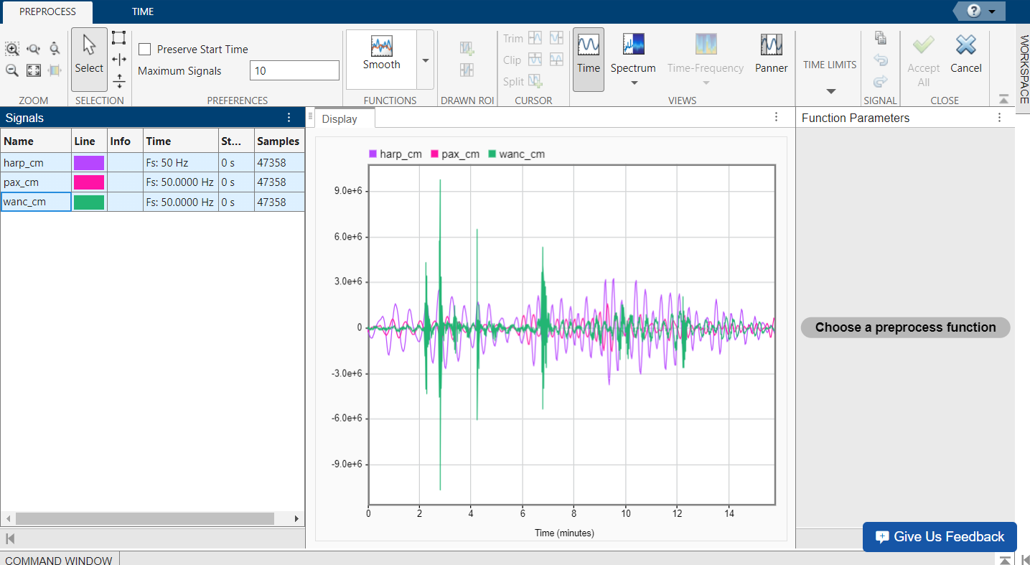
Task 1

Slide 22
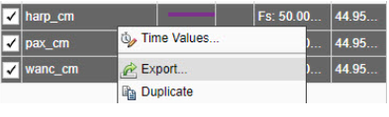
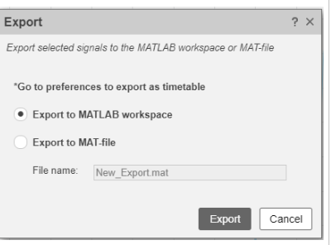
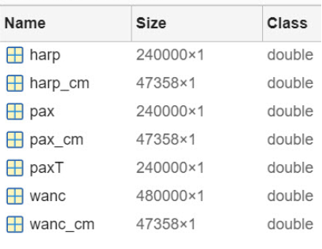
Task 2
Instead of adding functionality to Signal Analyzer, you may want to process your signals outside the app. In the next activity, you'll align these three signals to make it easier to compare the peaks. This requires using MATLAB functions outside of the app because the functions require multiple signals. To continue your work outside of Signal Analyzer, you can export the signals.
To export, right-click the signal and select Export.
#TASK
Export all three signals with centimeter units to the Workspace.

Slide 23
Align Signals

Slide 24
Task 1
Since all three seismic stations should have recorded the same surface waves, all three signals should be correlated. The alignsignals function uses cross-correlation to estimate and delay signals.
[xa,ya] = alignsignals(x,y)
If two signals have a sufficient correlation, the earlier output signal is padded with zeros.
#TASK
The signals with centimeter units were renamed back to harp, pax, and wanc to keep the variable names short.
Align harp and wanc. Use the same output variable names so that the visualization code at the bottom of the script plots the aligned signals.

Slide 25
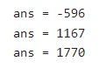
Task 1
Align Signals
This code imports the signals.
load processedsignals.mat
Use the finddelay function to find the signal that arrived last.
finddelay(harp,pax)
finddelay(harp,wanc)
finddelay(pax,wanc)
Based on the delay values to the right, you can conclude that:
harp arrived 596 samples after pax
harp arrived 1167 samples before wanc
pax arrived 1770 samples before wanc
So the wanc signal arrived last.
Task 1
[harp,wanc] = alignsignals(harp,wanc);

Slide 26
Task 2
Align the pax and wanc signals. Use the same output variable names so that the visualization code at the bottom of the script plots the aligned signals.
Task 2
[pax,wanc] = alignsignals(pax,wanc);
%This code plots the signals from the HARP and PAX stations.
plot(harp)
hold on
plot(pax)
plot(wanc)
hold off
legend("HARP","PAX","WANC")

Slide 27
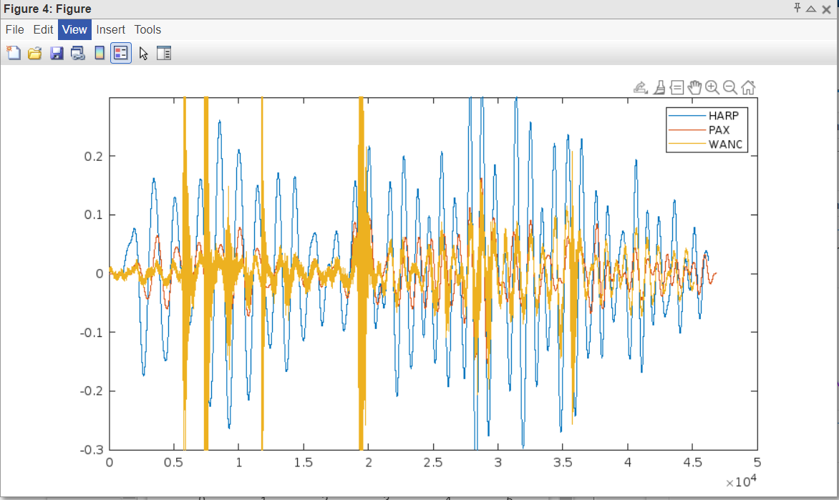
In this plot, you can see the signals now look aligned.

